Slide 1
Serverless in your everyday

Slide 2
About me
Work at AWS on the Integration and Automation Team
Have a cattle Ranch
(Yes this is my hobby and why I work at AWS)
I have 3 foster kids under 3
www.linkedin.com/in/troy-ameigh

Slide 3










Serverless is more than compute
COMPUTE
AWS Lambda
AWS Fargate
DATA STORES
Amazon S3
Amazon Aurora Serverless
Amazon DynamoDB
INTEGRATION
Amazon EventBridge
Amazon API Gateway
Amazon SQS
Amazon SNS
AWS Step Functions
AWS AppSync
Notes:
While many customers associate serverless with Lambda, there are actually serverless services at all layers of the stack.
And while Lambda offers many key advantages for our customers, it’s really when all these other components surround Lambda that we start to see much bigger benefits. Messaging, orchestration, storage and compute together are the secret sauce. But In fact, it’s really when all of these components come together that we really start to see big gains.

Slide 4
What do I use Serverless for everyday
With GitHub
Code Security Scanning
Code Linting
Launching End-to-End tests
Ensuring security is properly configured across my repos
Building and publishing Documentation

Slide 5
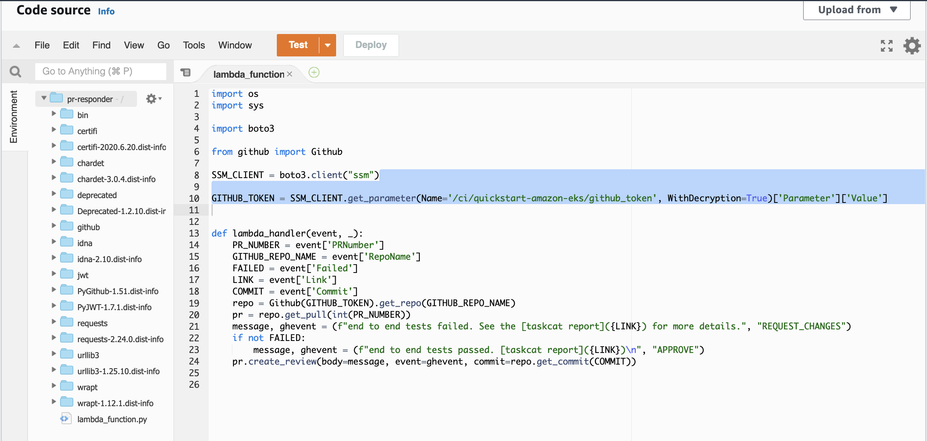
GitHub and Lambda

Slide 6
Containers for?
Running applications instead of installing them
Having a standardize tool set for your team.
Code Development
Running routine tasks

Slide 7
Thank you

